Slide 1
Motion, Speed, Velocity and Acceleration

Slide 2
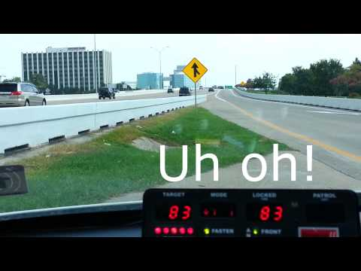
Motion

Slide 3
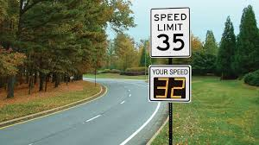
Radar Speed Signs

Slide 4

Motion
Motion – an object’s change in position relative to a reference point

Slide 5




Reference Point
The Earth’s surface is used as a common reference point
A moving object can be used as a reference point as well

Slide 6
Speed
Speed is the distance traveled divided by the time interval during which the motion occurred
Normally, objects do not travel at a constant speed
Average Speed - total distance
total time

Slide 7
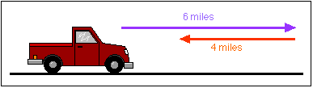
Which Distance?
Farmer Jones drives 6 miles down a straight road. She turns around and drives 4 miles back. What was her average speed for this trip if it took 1 hour?

Slide 8
Your answer to this problem depends on your interpretation of "distance traveled". You could say:
The total distance traveled by Farmer Jones is 10 miles. Therefore her average speed is 10 mi/hr.
The net distance traveled by Farmer Jones is 2 miles. Therefore, her average speed is 2 mi/hr.
There are good reasons to use either interpretation - it's mostly a matter of preference. We will interpret "distance traveled" to be net distance (also called displacement). Farmer Jones' average speed was 2 mi/hr.

Slide 9
Compare and Contrast
What is the difference between Total distance and displacement?
The net distance (displacement) traveled by Farmer Jones is 2 miles.
It is how far she is from the starting point .
Notes:
Deciphering the meaning of a text, image, or graph is an important thinking skill. Help students practice by asking them to type their interpretation of a particular text or image you are working with. Ask, “What do you think the author is trying to say?” and, “Try to say it another way.”
🍐 This is a Pear Deck Text Slide
🍐 To edit the type of question, go back to the "Ask Students a Question" in the Pear Deck sidebar.

Slide 10
Velocity
Velocity is the speed of an object in a particular direction
Imagine two birds leave the same tree at the same time. The both fly at 10km/hr for 5 minutes. Why don’t they end up at the same place?

Slide 11



Slide 12
Velocity
Velocity appears to be very similar to speed, however, when describing the velocity of an object you need to provide a magnitude and a direction
Magnitude – the speed of the object
Direction – the direction the object is moving

Slide 13
Velocity
Ex) A bus has a velocity of 35miles/hr heading west

Slide 14
Resultant Velocity
An object can have a resultant velocity if it is experiencing more than one motion.
For example if a person walks down the center of a bus while it is in motion there are two velocities occurring.
1. The movement of the bus
2. The movement of the person inside the bus

Slide 15

Example
15 m/s
+
1 m/s
=
14 m/s

Slide 16



Drag your dot to how you are feeling:
Keep going, I understand
I’m a little confused
Stop, I need help!
Notes:
🍐 This is a Pear Deck Draggable™ Slide.
🍐 You can change the prompt and the "feelings" to fit your class.

Slide 17

Example
15 m/s
+
1 m/s
=
16 m/s

Slide 18
Velocity Calculation
Bob rides his bicycle on a bike path that is 75 kilometers long to get to his house that is due east of the bike path. If it takes Bob 15 hours then what is his velocity.
Notes:
🍐 This is a Pear Deck Drawing Slide
🍐 To edit the type of question, go back to the "Ask Students a Question" in the Pear Deck sidebar.

Slide 19

Summarize what you’ve just learned:
Notes:
🍐 This is a Pear Deck Text Slide.

Slide 20
Acceleration
Acceleration is the rate at which velocity changes over time
An object accelerates if its speed, direction, or both change
Average acceleration =
final velocity – starting velocity
time it takes to change velocity

Slide 21
Example Problem
A car on the highway is traveling 55 mi/hr and it passes another car. In order to pass, the car has to accelerate to 65 mi/hr. The car reaches this velocity 40 seconds later. What is the average acceleration of the car?
Notes:
🍐 This is a Pear Deck Drawing Slide
🍐 To edit the type of question, go back to the "Ask Students a Question" in the Pear Deck sidebar.

